Slide 1

Project Title
Bitcoin Trading Data Analysis

Slide 2
Scope of the Project
The project scope involves developing a machine learning tool to analysis and predict BTCUSD (Bitcoin to US Dollar) exchange rates for effective market prediction and trading strategy formulation.

Slide 3
Project Description
Data Collection : From Yahoo Finance.
Data Preprocessing : Scaling the data, Spilt the Data
Model Development : Utilizing Sequential LSTM Model
Model Evaluation & Optimization
Visualization & Presentation
Documentation & Code Structuring
Project Delivery and Future Work

Slide 4
Research Questions to Answer
How can a machine learning tool be contributing to more accurate market predictions ?
1
How can the incorporation of statistical and trend analysis within the development of a machine learning tool ?
2
Model Evaluation and Refinement:
(considerations … to trust model …r_sq, mse)
3

Slide 5
Dataset to be used
Source: Bitcoin historical data from Yahoo Finance.
Timeframe: January 1,2022 to November 15,2023.
Features : Open, High, Low, Close and Volume Prices of Bitcoin.

Slide 6
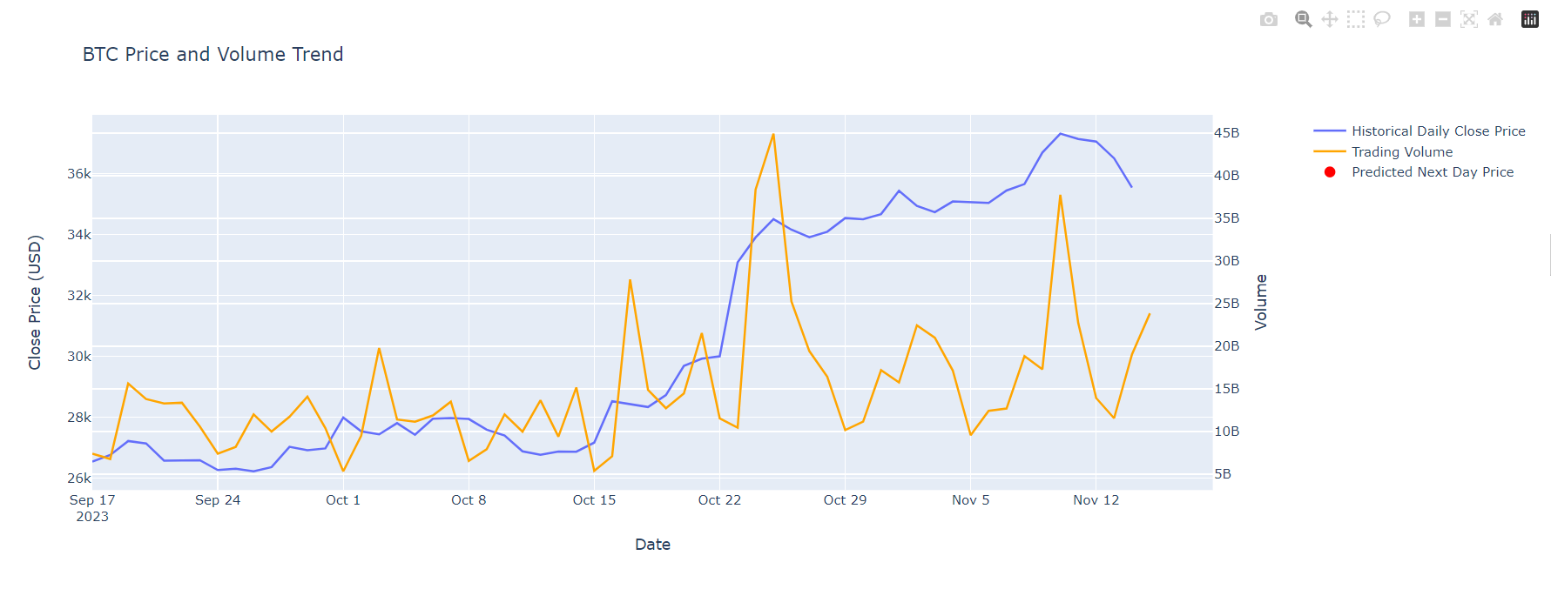
Analysis on BTC Price and Volume Trend

Slide 7
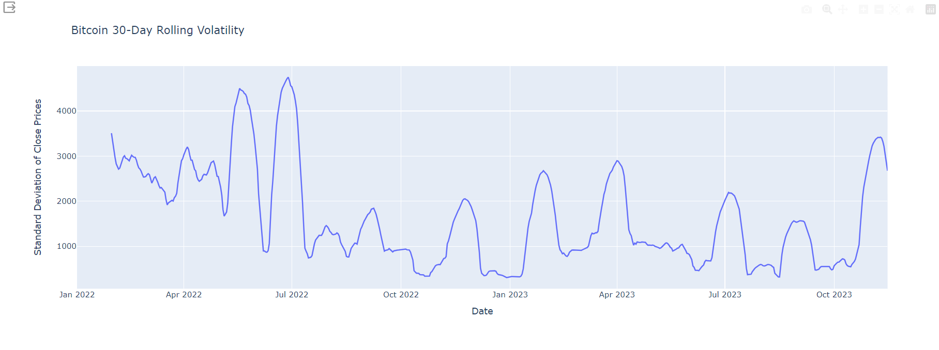
Analysis on Bitcoin 30-Day Rolling Volatility

Slide 8
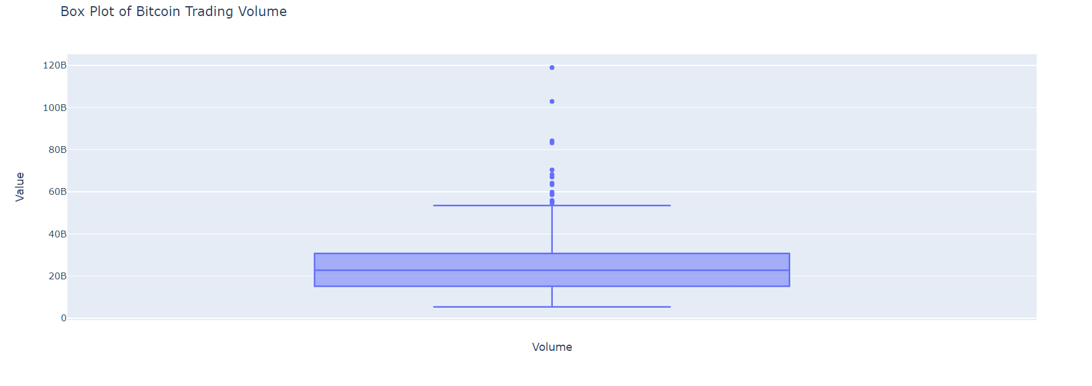
Analysis on Bitcoin Trading Volume

Slide 9
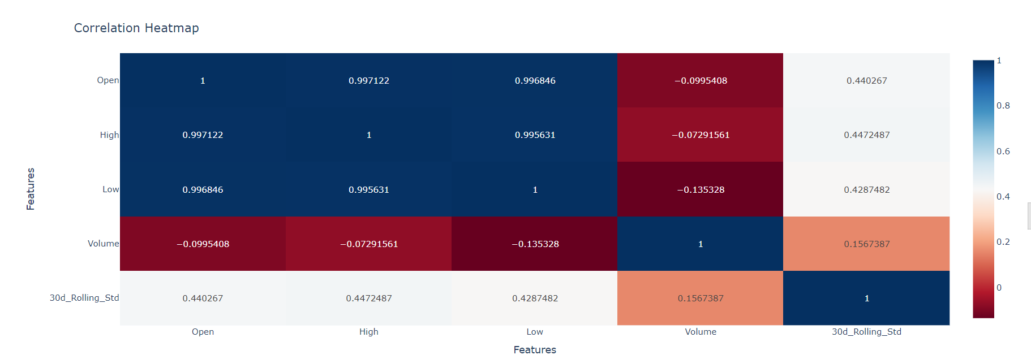
Analysis on Correlation Heatmap

